Slide 1
AUTONOMUS HEAVY CONSTRUCTION EQUIPMENT
PRESENT BY PRATEEK SRIVASTAVA

Slide 2
Types of heavy equipment
1 = Excavators
2 = Backhoe
3 = Dragline Excavator
4 = Bulldozer
5 = Graders
6 = Wheel Tractor Scrapper
7 = Trenchers
8 = Loaders

Slide 3
9 = Tower Crane
10= Pavers
11= Compactors
12= Telehandlers
13= Feller Bunchers
14= Dump Truck
15= Pile Boring Machine
16= Pile Driving Machine

Slide 4
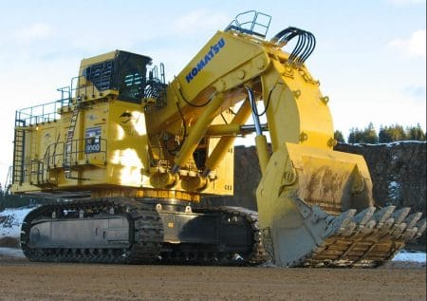
1 EXCAVATORS
Excavators are important and widely used equipment in construction industry. Their general purpose is to excavation but other than that they are also used for many purposes like heavy lifting, demolition, river dredging, cutting of trees etc.

Slide 5
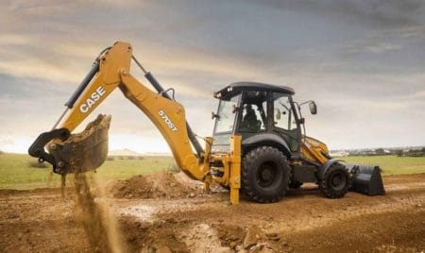
2 Backhoe
Backhoe is another widely used equipment which is suitable for multiple purposes. The name itself telling that the hoe arrangement is provided on the back side of vehicle while loading bucket is provided in the front.

Slide 6
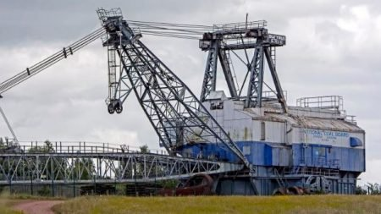
3 Dragline Excavator
Dragline excavator is another heavy equipment used in construction which is generally used for larger depth excavations. It consists a long length boom and digging bucket is suspended from the top of the boom using cable.
For the construction of ports, for excavations under water, sediment removal in water bodies etc. can be done by dragline excavator.

Slide 7
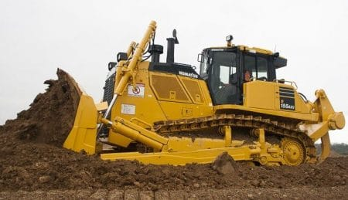
4 Bulldozer
Bulldozers are another type of soil excavating equipment which are used to remove the topsoil layer up to particular depth. The removal of soil is done by the sharp edged wide metal plate provided at its front. These are widely used for the removal of weak soil or rock strata, lifting of soil etc.

Slide 8
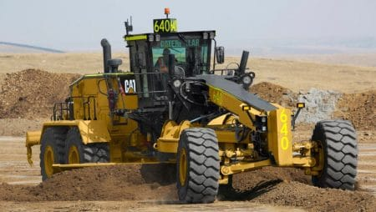
5 Graders
Graders also called as motor graders are another type of equipment used in construction especially for the construction of roads. It is mainly used to level the soil surface. It contains a horizontal blade in between front and rear wheels and this blade is lowered in to the ground while working.

Slide 9
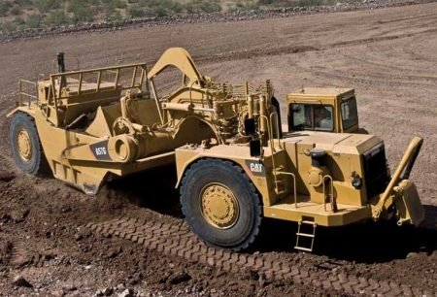
6 Wheel Tractor Scrapper
Wheel Tractor Scrapers are earth moving equipment used to provide flatten soil surface through scrapping. Front part contains wheeled tractor vehicle and rear part contain a scrapping arrangement such as horizontal front blade, conveyor belt and soil collecting hopper.

Slide 10
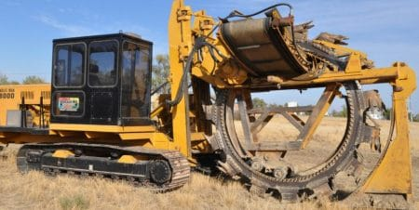
7 = Trenchers
Trenchers or Trenching machines are used to excavate trenches in soil. These trenches are generally used for pipeline laying, cable laying, drainage purposes etc. Trenching machines are available in two types namely chain trenchers and wheeled trenchers.

Slide 11
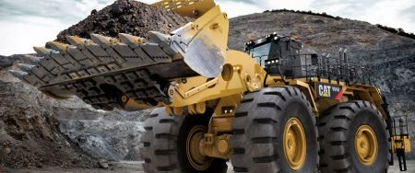
8 = Loaders
Loaders are used in construction site to load the material onto dumpers, trucks etc. The materials may be excavated soil, demolition waste, raw materials, etc. A loader contain large sized bucket at its front with shorter moving arm.

Slide 12
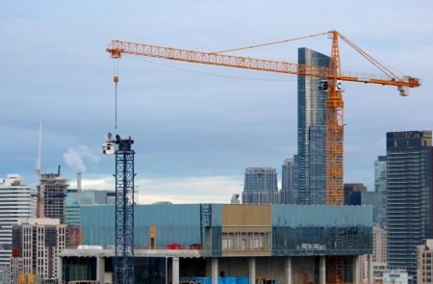
9 Tower Crane
Tower cranes are fixed cranes which are used for hoisting purposes in construction of tall structures. Heavy materials like pre-stressed concrete blocks, steel trusses, frames etc. can be easily lifted to required height using this type of equipment.

Slide 13
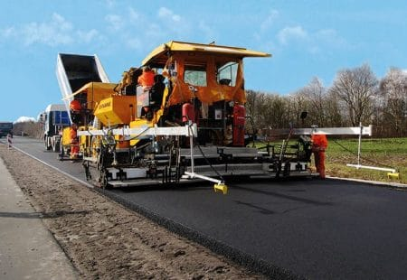
10 Pavers
Paver or Asphalt paver is pavement laying equipment which is used in road construction. Paver contains a feeding bucket in which asphalt is continuously loaded by the dump truck and paver distributes the asphalt evenly on the road surface with slight compaction.

Slide 14
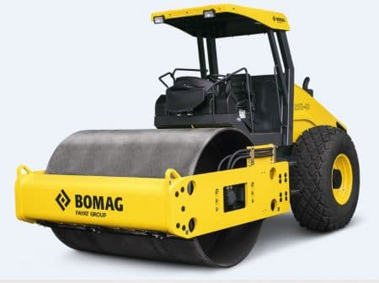
11 Compactors
Compactors or Rollers are used to compact the material or earth surface. Different types of compactors are available for different compacting purposes.
Smooth wheel rollers are used for compacting shallow layers of soil or asphalt etc. sheep-foot rollers are used for deep compaction purposes.

Slide 15
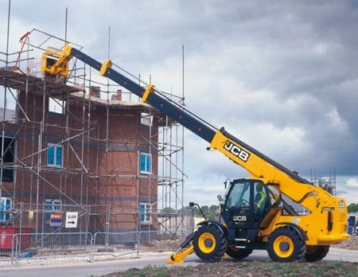
12 Telehandlers
Telehandlers are hoisting equipment used in construction to lift heavy materials up to required height or to provide construction platform for workers at greater heights etc. It contains a long telescopic boom which can be raised or lowered or forwarded.

Slide 16
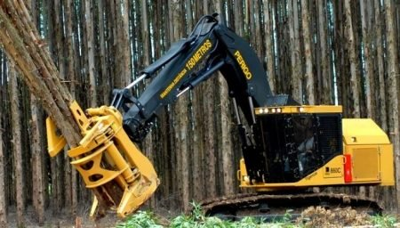
13 Feller Bunchers
Feller buncher is tree cutting heavy equipment used to remove large trees in the construction field. They cut the tree and grab it without felling, likewise gathers all the cut down trees at one place which makes job easier for loaders and dump trucks.

Slide 17
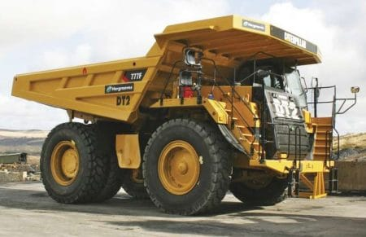
14 Dump Truck
Dump trucks are used in construction sites to carry the material in larger quantities from one site to another site or to the dump yard. Generally, in big construction site, off-road dump trucks are used .These off-road dump trucks contains large wheels with huge space for materials which enables them to carry huge quantity of material in any type of ground conditions.

Slide 18
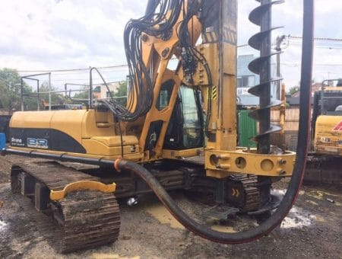
15 Pile Boring Machine
Pile boring equipment is used to make bore holes in the construction site to install precast piles.

Slide 19
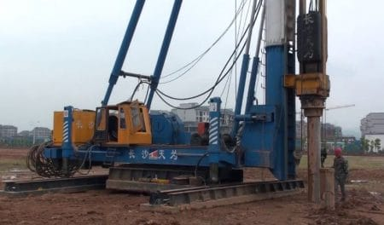
16 Pile Driving Machine
Heavy equipment used in construction site is pile driving equipment in case of pile foundation construction. This equipment lifts the pile and holds it in proper position and drives into the ground up to required depth.

Slide 20
History of autonomous construction equipment
Research on automated excavation first began with Unmanned, Remote controlled Excavators developed by Japan in the 1980s, and some of the prominent studies that followed include the Autonomous Loading System (Cannon 1999; Singh and Simmons 1992; Stentz et al. 1999) developed by Carnegie Mellon University in the 1990s; the Autonomous Hydraulic Excavator ( Yamamoto et al. 2009) developed by the Public Works Research Institute (PWRI) in 2008, and the Intelligent Excavation Robot (IES) developed by Korea in 2011.
Among these, the intelligent excavation robot (IES) recently developed by Korea is a fully automated excavation robot that is capable of autonomous driving, 3D modeling, excavation task planning, autonomous excavation, loading, etc. IES features global 3D modeling capabilities of the entire worksite and an intelligent task planning system

Slide 21
Scope of autonomous construction equipment
The autonomous construction equipment are all set to change the dynamics of construction industry and projected to grow with 28.7% during the forecast period from 2018 to 2026.
Construction industry is considered as one of the least efficient industries; although, the industry has been registering market value of more than US$ 10 Tn consistently in past few years.
It is expected that the global market for autonomous construction equipment would expand as the manufacture of construction vehicles gathers swing in recent times.
Moreover the reduced costs of handling construction materials through the use of handling equipments shall also aid market growth in the years to come.

Slide 22
Research on autonomous construction equipment
3D SURROUND LOCAL SENSING SYSTEM FOR INTELLIGENT EXCAVATION ROBOT (IES).
DEVLOPMENT OF EARTHMOVING MACHINARY AUTONOMOUS EXCAVATOR DEVLOPMENT PLATFORM.
EARTHMOVING CONSTRUCTION AUTONOMATION WITH MILITARY APPLICATION.
FAST DATASET COLLECTION APPROACH FOR ARTICULATED EQIPMENT POSE ESTIMATION.
AUTONOMOUS MOTION PLANNING AND TASK EXCUTION IN ROBOTIZED CONSTRUCTION WORK.
IMPROVED SOIL SHAPE ON DUMP TRUCK FOR SOIL LOADING OPERATION OF EXCAVATOR.

Slide 23
LIGHTWEIGH AND HIGH STRENGTH DESIGN OF EXCAVATOR BUCKET UNDR UNCERTAIN LOADING.
INTERNAL PARAMETER ESTIMATION FOR THE DYNAMIC SIMULATION OF A HYDRAYULIC EXCAVATOR.

Slide 24
Thank you

