Slide 1
BIO ELECTRONIC EYE(BIONIC EYE)
Presentation By Rajesh Shrivastava,Asst Professor ECE

Slide 2
….I SHUT MY EYES AND ALL THE WORLD DROPS DEAD;I LIFT MY EYES AND ALL IS BORN AGAIN ….SYLVIA PLATH

Slide 3
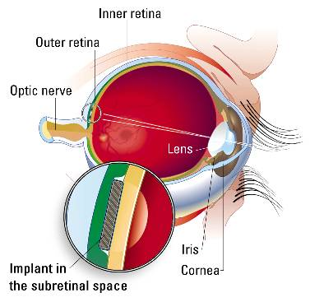
The Eye

Slide 4
BIONIC EYE ?
Bio-electronic eye
Electronic device which replaces functionality of a part or whole of the eye
Used for replacing functionality or Adding functionality to the eye

Slide 5
TECHNOLOGIES APPLIED IN BIONIC EYE
MIT-Harvard Device
ASR(Artificial Silicon Retina)
MARC
Holographic Technology

Slide 6
MIT-Harvard device
Features
Epi-Retinal Approach
Microelectrode array replaces damaged photoreceptors
Power source – Laser(820nm wavelength)
Image Acquisition - Using CCD Camera
Patient spectacle holds the camera and power source

Slide 7
ASR(ARTIFICIAL SILICON RETINA)
ASR is a solid state biocompatible chip which contains an array of photo receptors ,and is implanted to replace the functionality of the defective photoreceptors .
Current generated by the device in response to light stimulation will alter the membrane potential of the overlying neurons and thereby activate the visual system.

Slide 8
Limitations Of ASR’s
ASR is designed to interface and function with the retina that has partial outer retinal degeneration.
ASR can be applied only when the photoreceptor cellular layer of the retina is damaged but the remaining cellular layers are still functional.

Slide 9
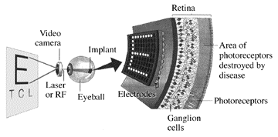
MARC(MULTIPLE UNIT ARTIFICIAL RETINA CHIPSET)

Slide 10
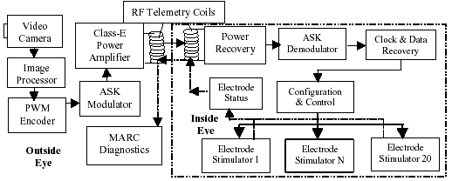
MARC System Block Diagram

Slide 11
HOLOGRAPHIC TECHNOLOGY
Computer generated holography could be used in conjunction with a technique called optogenetics which uses gene therapy to deliver light sensitive proteins to damaged retinal nerve cells
The basic idea of optogenetics is to take a light sensitive protein from another organism and insert it into a target cell and that photosensitizes the cell.

Slide 12
Conclusion
Its been 40 years since Arne Larsson received the first fully implanted cardiac pacemaker at the Karolinska Institute in Stockholm.
Researchers throughout the world have looked for ways to improve people's lives with artificial, bionic devices.
Bionic devices are being developed to do more than replace defective parts.
Researchers are also using them to fight illnesses.
Providing power to run bionic implants and making connections to the brain's control system pose the two great challenges for biomedical engineering.
We are now looking at devices like bionic arms, tongues, noses etc.

Slide 13
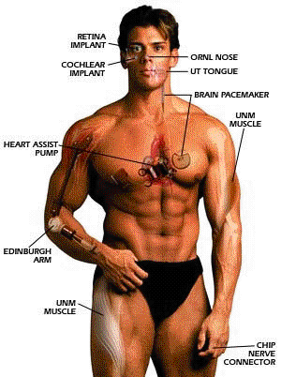
Future scope(Bionic Man?)

Slide 14
Thank
you

