Slide 1
Multilevel Parking For Light Vehicles
VISION INSTITUTE OF TECHNOLOGY , KANPUR
Department Of Civil Engineering
Presented by: Mohammad Javed
(Asst. Professor CIVIL Engineering)

Slide 2
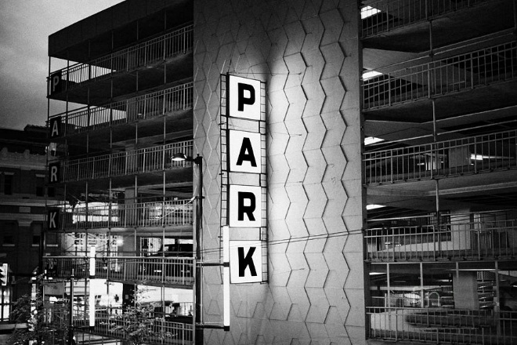
Multi level car parking

Slide 3
Introduction
Car parking has been, and still is, a growing problem, with increasing vehicle sizes in the luxury segment.
A multi-level car parking is essentially a building with number of floors or layers for the cars to be parked. The different levels are accessed through interior or exterior ramps.
Parking is an essential component of the transportation system. It is increasingly becoming an important aspect of transportation planning.
Public parking spaces are one of the important parts of a modern urban transportation system, plays an important role in decreasing the load of heavy traffic.
Car parking is an issue of significance both at the local and at the strategic level of planning.

Slide 4
A systematic study of parking characteristic, demand and regulatory measures that are possible for controlling is of great help to a traffic engineers as well as town planner.
Though there are parking lots available in these cities, the capacity of the parking lot is not sufficient to cater to the present demand and at the same time the location of the parking lot is questionable.
In the absence of adequate parking facilities, the vehicles are parked on the side of the street leading to a major bottleneck in the smooth flow of traffic.

Slide 5
Parking Issues In Kanpur
The vehicle population in Kanpur has been steadily increasing with the pace picking up significantly since the nineteen eighty.
The annual growth rate of vehicles at 10% per annum is more than the growth rate of population which is 3%.
In Kanpur , approximately 45% of the road users use public transport.
The city roads have already been suffering from congestion.
The problem of congestion is compounded by the fact that parking is free in Kanpur and on-street parking is unregulated.
As a result, parked vehicles take up precious road space leaving less road space for moving vehicles.

Slide 6
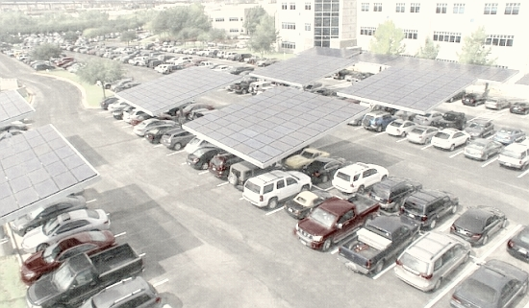
Difficulty in Finding Vacant Spaces.
Improper Parking.
As a response to the parking problems in Kanpur, Kanpur Municipal Corporation (KMC) intends to develop multi-level parking facilities across Kanpur .

Slide 7
Traffic Jam At Parade Chauraha

Slide 8
Vehicles Parked At Naveen Market

Slide 9
Objectives Of The Study
To carry out the literature review on car parking. ( light motor vehicles [LMV])
To check the stability of the structure against wind.
To carry out the survey of different types of vehicles in Kanpur.
To identify the suitability of conventional car parking.
To assess the existing parking demand and supply for the study area.
To assess how the existing car parking facility can be optimally used.
To improve vehicular circulation in and around the study area.

Slide 10
Methodology
Opinion Survey
Opinion surveys will be conducted to elicit the opinion of the users about the facilities available for parking and about their willingness to pay the fee for using the proposed facility.
The survey will be done on a random sample basis during peak and off- peak periods.
This survey was conducted on both weekdays and weekends.
Outcome of the survey include identification of influence on area of the market, frequency of the visit, purpose of the visit, problems with existing parking facility, occupancy rate, opinion about the existing parking rate and about the future parking charge system with improved parking facility.

Slide 11
Public Survey

Slide 12
Site Survey
In order to understand the site, a site survey is essential.
This survey will be carried out for the study area to capture the road characteristics like available right of way (ROW) and carriageway width.
Land use in the site vicinity will be surveyed. Major establishments and trip generators will be identified.
Traffic circulation and accessibility to the site will be assessed.
Other relevant issues like unauthorized parking, unused bus stops etc. will be flagged and accordingly issues will be identified.

Slide 13
Survey Of Present Parking Facilities
Off- street surveys i.e. at multilevel car parking [MLCP] to analyse parking demand and its characteristics.
Opinion surveys elicited opinion of the users about the facilities available for parking and their willingness to pay the fee for using the facility. The opinion survey also reveals the extent of suppressed parking demand.
Inventory surveys will be conducted to collect the potential of the existing facility in terms of available space, road characteristics, type of parking, land use of the location, etc.
On-street parking surveys will be carried out to study the parking characteristics and demand along with roadside accumulation survey for the parked vehicles.

Slide 14
On Street (Left) & Off Street (Right) Parking

Slide 15
Automated Multilevel Parking
• Puzzle Type or Modular • Elevated Type or Tower • Multi-Level Floor Parking •Circulation Automated Parking System • Rotary type • D (Stacker) System

Slide 16
Circulation Automated Parking System
Elevated Type or Tower

Slide 17
Keywords:
RFID technology
GSM
QR Code
Robotics

Slide 18
Advantages Of Multilevel Parking
Maximum utilization of ground space.
Quick entry and exit due to the independent operation.
Designed for driver convenience.
Partial breakdown doesn't affect the other parts.
Multiple safety guarantee of the drivers and the cars too.
Provides smooth flow of traffic & thus reduce the travel time.
Require less building volume and less ground area.
Number of accidents are reduced due to this system.

Slide 19
THANK YOU

