Slide 1
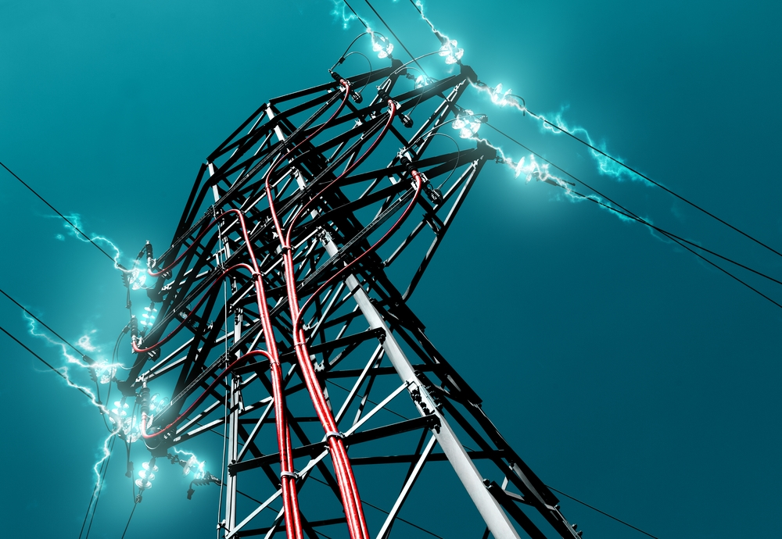
INTRODUCTION TO POWER QUALITY AND FACTS
Shivani Mishra
Lecturer (EN)

Slide 2
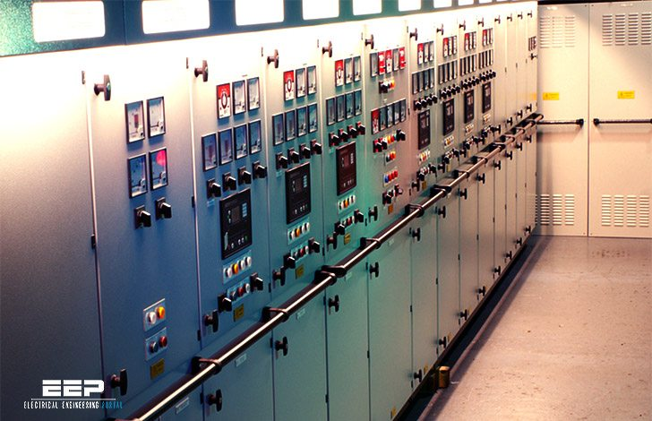
Voltage sag (or dip)
Very short interruptions
Long interruptions
Voltage spike
Voltage swell
Harmonic distortion
Voltage fluctuation
Noise
Voltage Unbalance

Slide 4
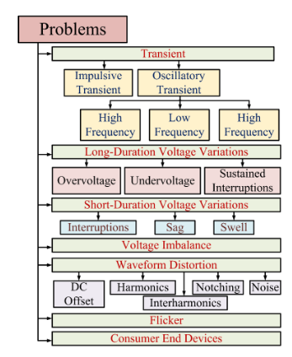
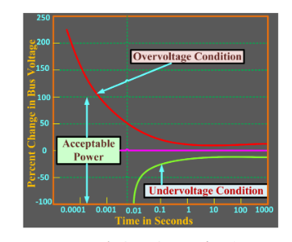
CBEMA CURVE
This standard specifies the minimum withstanding capability of computer equip-ment to voltage sags, micro-interruptions and over-voltages.

Slide 5
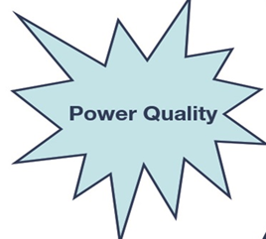
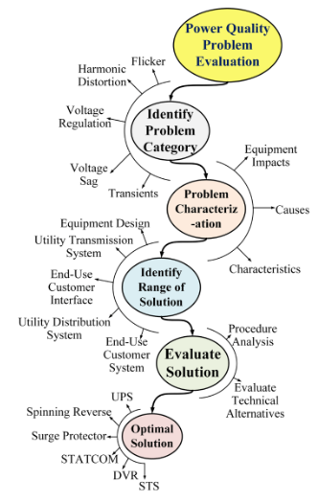

Slide 6
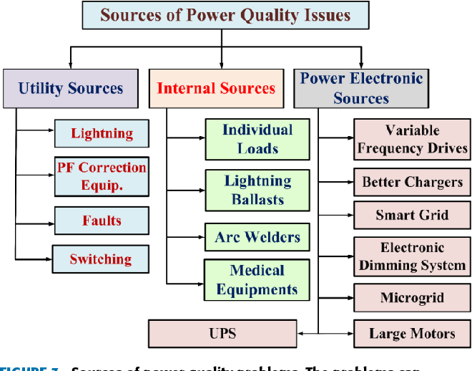
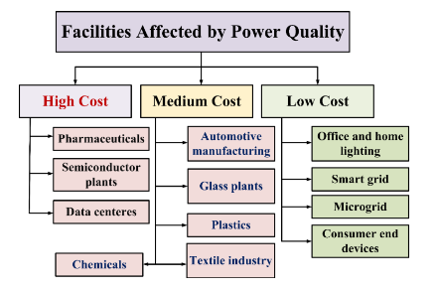

Slide 7
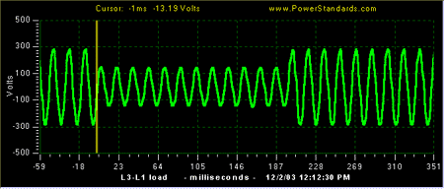
Voltage Sag
Voltage sags – or dips which are the same thing – are brief reductions in voltage, typically lasting from a cycle to a second or so, or tens of milliseconds to hundreds of milliseconds.

Slide 8
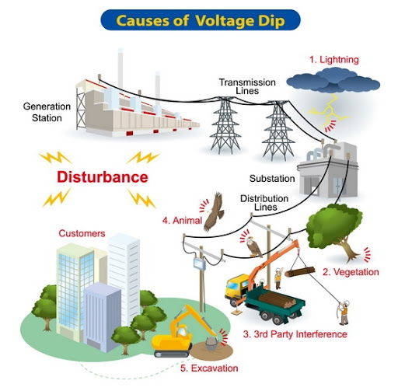
Voltage Sag Causes
Power systems have non-zero impedances, so every increase in current causes a corresponding reduction in voltage. Usually, these reductions are small enough that the voltage remains within normal tolerances. But when there is a large increase in current, or when the system impedance is high, the voltage can drop significantly.
So conceptually, there are two sources of voltage sags:-
Large increases in current
Increases in system impedance

Slide 9
Voltage Sag Mitigation
Different mitigation methods are
o Dynamic voltage restorer
o Active series Compensators
o Distribution static compensator (DSTATCOM) or Solid state transfer switch (SSTS)
o Static UPS with energy storage
o Backup storage energy supply (BSES) o Ferro resonant transformer
o Flywheel and Motor Generator set
o Static Var Compensator (SVC)

Slide 10
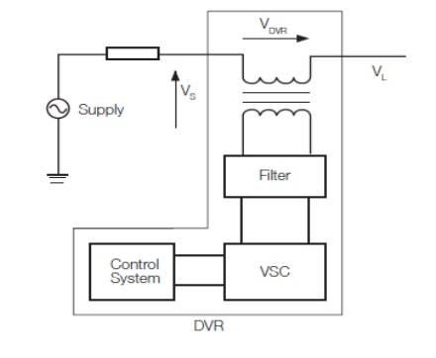
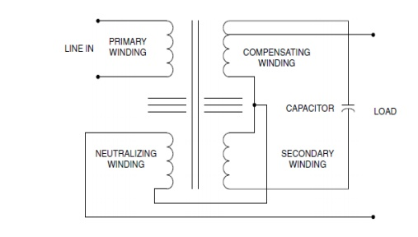
Dynamic Voltage Restorers (DVR) are complicated static devices which work by adding the ‘missing’ voltage during a voltage sag. Basically this means that the device injects voltage into the system in order to bring the voltage back up to the level required by the load.
A Ferro resonant transformer, also known as a constant voltage transformer (CVT), is a transformer that operates in the saturation region of the transformer B-H curve.
Voltage sags down to 30 % retained voltage can be mitigated through the use of Ferro resonant transformers.

Slide 11
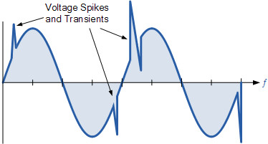
Electrical Transients
Transients are power quality disturbances that involve destructive high magnitudes of current and voltage or even both. It may reach thousands of volts and amps even in low voltage systems. However, such phenomena only exist in a very short duration from less than 50 nanoseconds to as long as 50 milliseconds.

Slide 12
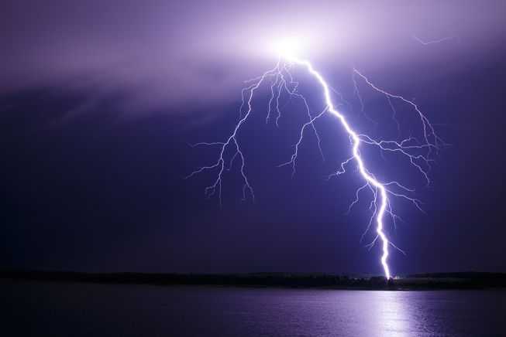
Sources of Transients
Lightning Strikes
Switching activities
· Opening and closing of disconnects onenergized lines
· Capacitor bank switching
· Reclosing operations
· Tap changing on transformers
3.Loose connections in the distribution system that results to arcing Accidents, human error, animals and bad weather conditions Neighboring facilities.

Slide 13
Effect of Transients
Electronic Equipment
Ø Equipment will malfunction and produces corrupted results
Ø Improper specification and installation of TVSS can aggravate the failures
Ø Efficiency of electronic devices will be reduced
Motors
Ø Transients will make motors run at higher temperatures
Ø Result in micro-jogging leading to motor vibration, excessive heat and noise
Ø Degrades the insulation of the motor winding resulting to equipment failure.
Ø Increases the motor’s losses (hysteresis) and its operating temperature
Lights
Ø Fluorescent bulb and ballast failure
Ø Appearance of black rings at the fluorescent tube ends (indicator of transients)
Ø Premature filament damage leading to failure of the incandescent light.
Electrical Equipment
Ø Transients degrade the contacting surfaces of circuit breakers and switches
Ø Nuisance tripping of breakers due to false activation to a non-existent current demand
Ø Reduce transformer efficiency because of increased hysteresis losses

Slide 14
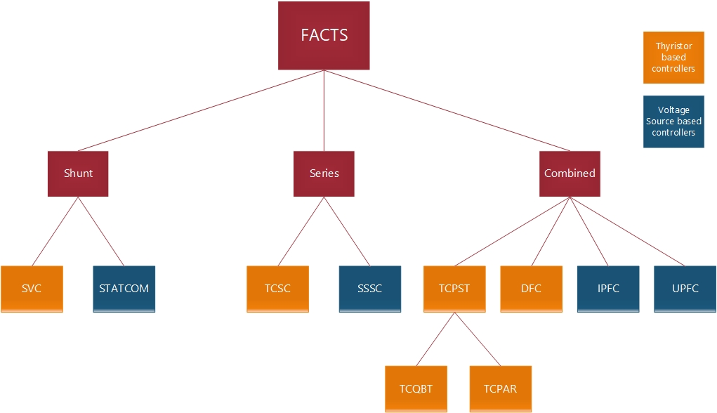
Flexible AC Transmission System
Flexible AC Transmission System (Facts) is a new integrated concept based on power electronic switching converters and dynamic controllers to enhance the system utilization and power transfer capacity as well as the stability, security, reliability and power quality of AC system interconnections.

Slide 15
FACTS controllers are in power system environments for enhancement of performance parameters of systems as RP support, minimize the AP losses, improvement in VP of systems, improvement in damping ratio of PSs, flexible operation and control of systems, etc. the application of FACTS controllers in PSs for enhancement of performance parameters of systems. The essential features of FACTS controllers and their potential to improve system stability is the prime concern for effective & economic operation of the power system.

Slide 16
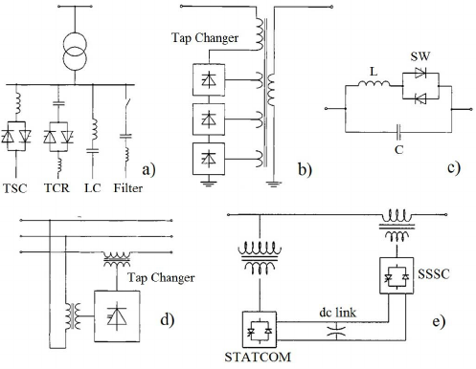
(a) SVC. (b) TCVR. (c) TCSC. (d) TCPST. (e) UPFC.

Slide 17
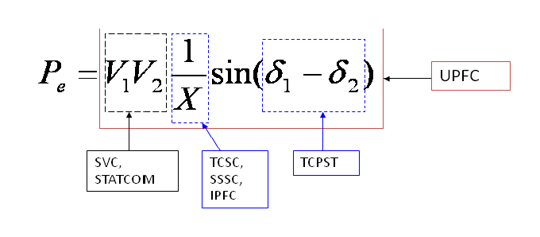
The transmittable power of this system can be simply represented by the
well–known equation below:-
where δ1and δ2are the angle of ˙
V1and V2. Assuming the magnitudes of the voltage at both
ends are invariant,
There are four main advantages to using FACTS -
1.Further exploit current transmission asset
2. Enhance the ﬂexibility and reliability of current transmission systems
3. Reduce the loop ﬂows.
4. Environmental beneﬁts.

Slide 18
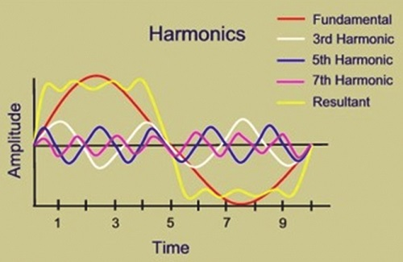
Harmonics In Power System
In an electric power system, a harmonic is a voltage or current at a multiple of the fundamental frequency of the system, produced by the action of non-linear loads such as rectifiers, discharge lighting, or saturated magnetic devices.

Slide 19
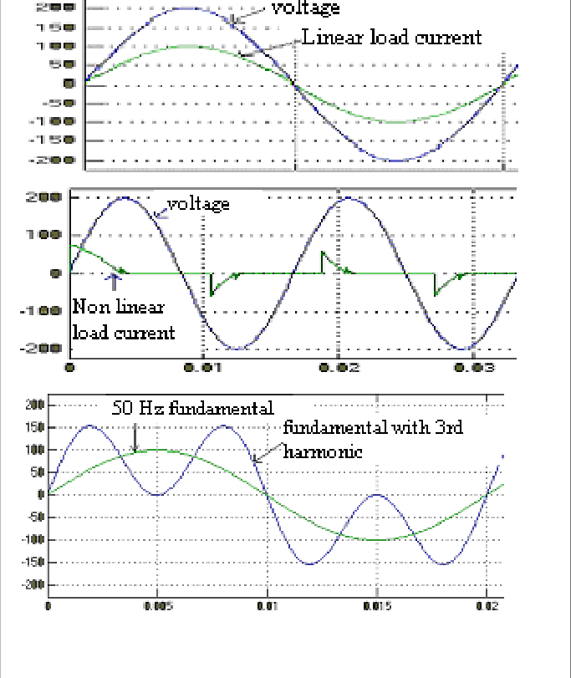
Non linear Loads & Harmonics
Switch-mode power supplies (SMPS), variable speed motors and drives, photocopiers, personal computers, laser printers, fax machines, battery chargers and UPSs are examples of nonlinear loads. Single-phase non-linear loads are prevalent in modern office buildings, while three-phase, non-linear loads are widespread in factories and industrial plants.
harmonics are distortion of the normal electrical current waveform, generally transmitted by nonlinear loads that draw a non sinusoidal current from a sinusoidal voltage source. A harmonic current increases power system heat losses, reduces system efficiency. Harmonic currents can have a significant impact on electrical distribution systems and the facilities they feed.

Slide 20
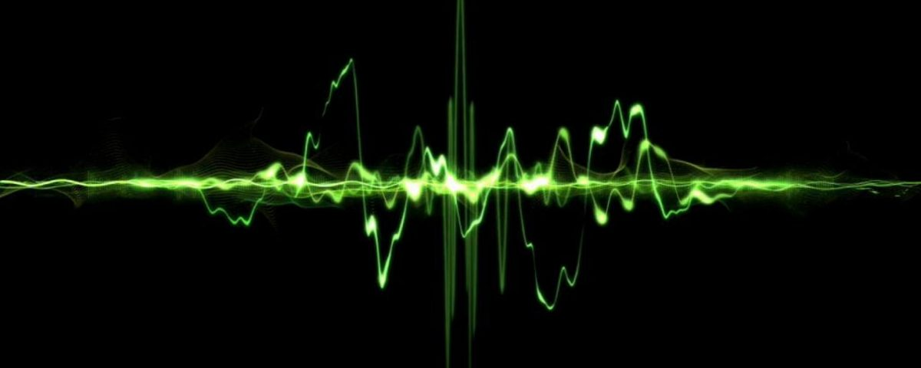
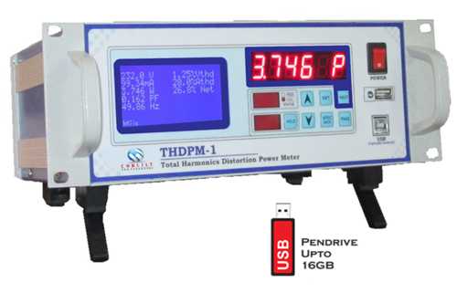
THD (Total Harmonic Distortion)
A common term that is used in relation to harmonics is THD or Total Harmonic Distortion. THD is a term used to describe the net deviation of non-linear waveform from ideal sine waveform. Total Harmonic Distortion is the ratio between the RMS values of the harmonics and the RMS value of fundamental.

Slide 21
Effects of Harmonics
Large load currents in the neutral wires of a 3 phase system. • High neutral-to-ground voltage often greater than 2 volts • communication errors, overheating and hardware damage • Overheating of electrical distribution equipment, cables, transformers, standby generators, etc. • High voltages and circulating currents caused by harmonic resonance • Generator Hunting • Electronic Control Clock errors • Quivering Monitors and CRT displays • Equipment malfunctions due to excessive voltage distortion • Nuisance tripping of circuit breakers • Metering errors needs true metering • zero-crossing noise • skin effect • Reducing system power factor, resulting in penalties on monthly utility bills overloading of neutrals

Slide 22
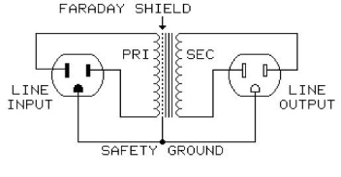
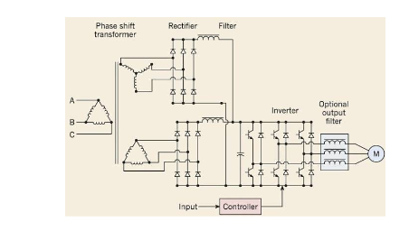
Harmonics Reduction Techniques
Line reactor
Isolation transformer
K-factor transformer
Tuned harmonic filter
IGBT based fast switched harmonic filter
Low pass harmonic filter
12 & 18 pulse rectifier
Phase shifting transformer
Active harmonic filters

Slide 23
Thank You
Keep Learning

